Slide 1
Project 2016:Tweet me
By Rachel Lawton

Slide 2
Project overview
My project is a device the measures the amount of water in a pets bowl and sends a tweet to the owner when the bowl is empty or full.

Slide 3
Why?
The main reason I chose to do this project was due to having a pet myself.

Slide 4
How it works
Water sensor Measures the resistance of water.
Resistance is the ease with which something will let electricity flow through it.
Water has low conductivity properties (insulator).
Insulators have a high resistance.

Slide 5
How it works
This information is then gathered by the Galileo, through pin 2.
This is then sent to Wyldiodrin where its used by the code
The code then determines what tweet to send based on the resistance
High Resistance = Full Low Resistance = Empty

Slide 6
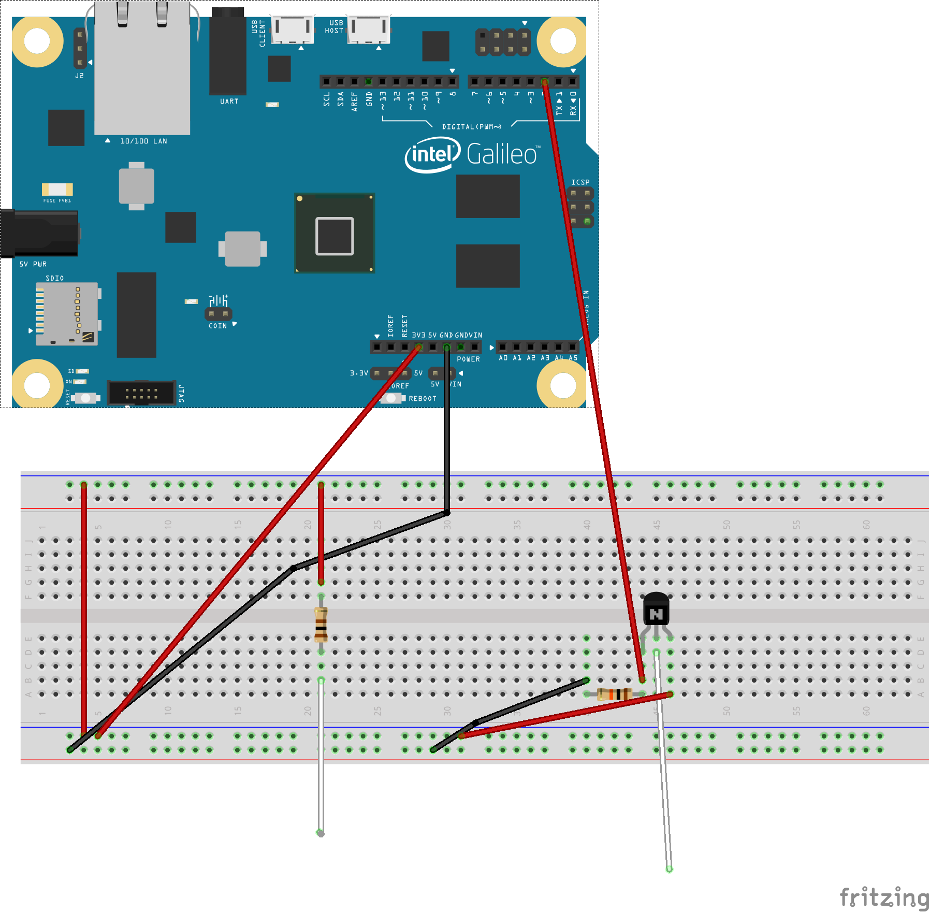
Project Design
Simple
Small
Durable

Slide 7




Technology

Slide 8
Skills from other modules
Programming Fundamentals 2:
Blocky
Boolean logic
If statements
Else if statements
Physics:
Resistance
Conductivity
Electricity
Web Development 2:
Html
Website
Github
Computer Systems:
Bread board
Sushi card

Slide 9

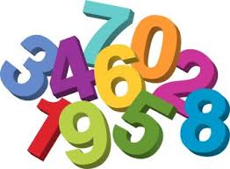
Problems I overcame
This first problem I solved was Repetition.
The second was Twitter.

Slide 10
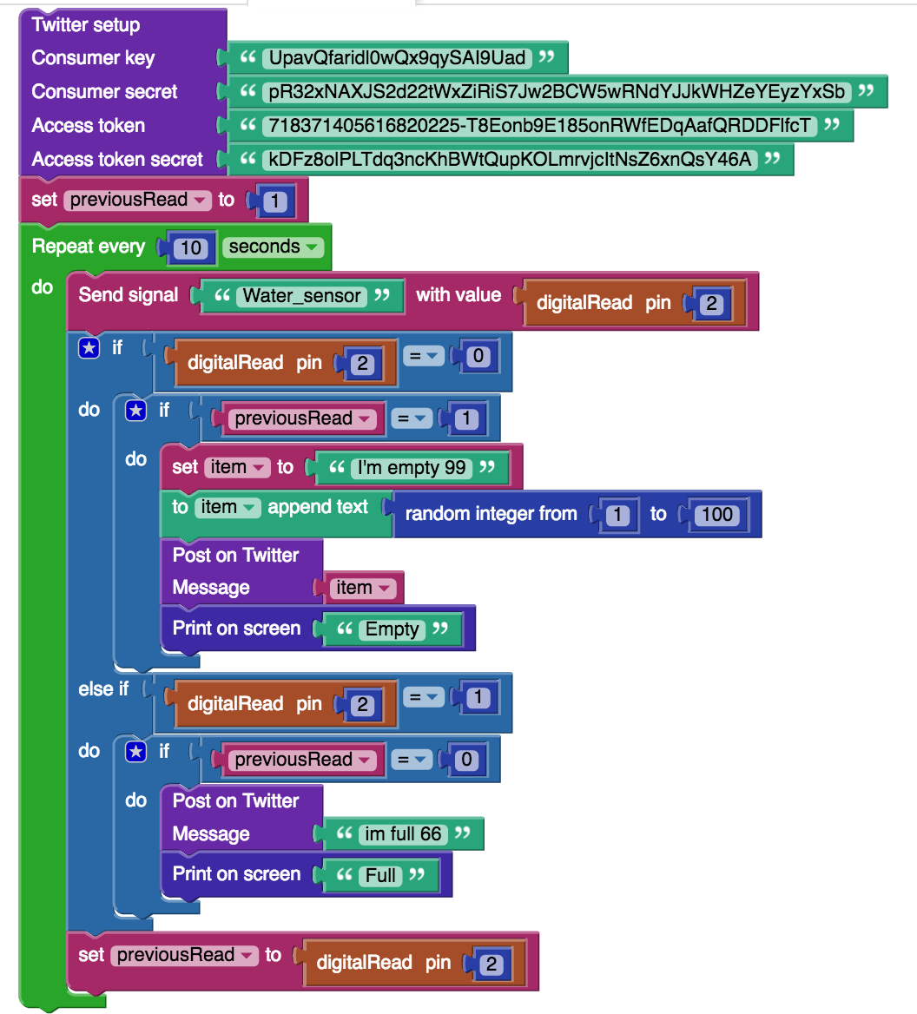
My code

Slide 11
Links
Github repository
https://github.com/RachelLawton/Project-2016.git
Website
http://rachellawton.github.io/Project-2016/
Twitter handle
https://twitter.com/Pet_bowl

Slide 12

Questions?

